Slide 1

Group 12 Week 10 Updates
JetSquidron
Cephalopod Inspired Robot Capable Of Jet Propulsion
2010121 - Fahim Faisal Munim
2010122 - Abu Zawad Ridwan
2010124 - Md. Saleh Uddin Ahmed
2010147 - Khan Mohammad Fahim

Slide 2
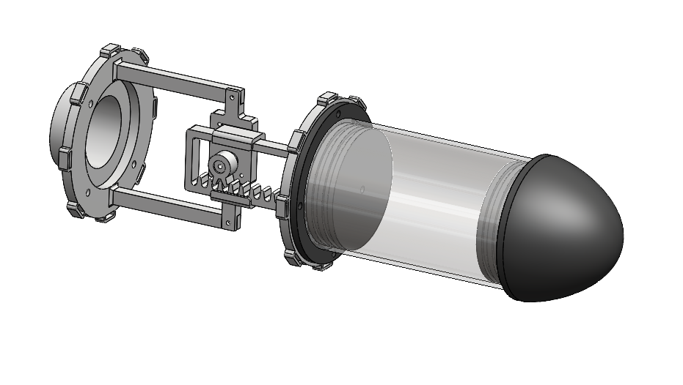
This Week's Progress
Electric housing design
3d Printing Parts
Purchase of Acrylic Pipe suitable for our Electric Housing
Waterproofing 3d printed part surface with epoxy resin
Watertighting the housing using O’ring on both ends

Slide 3
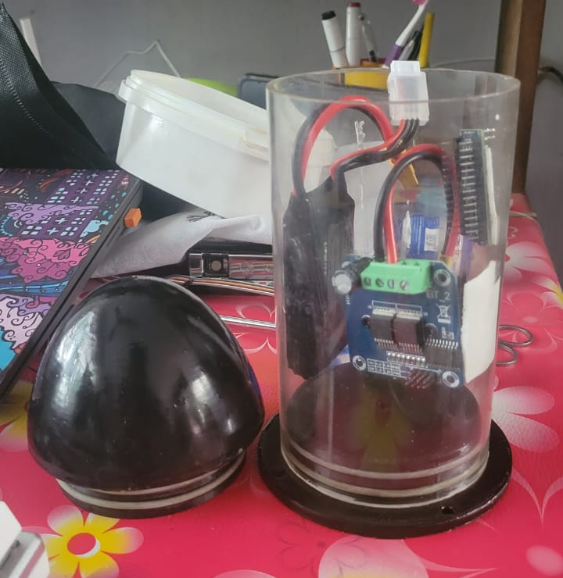
Next Course of action
Wiring of Electric components
Finding out proper nozzle dia
Untethered swimming test

Slide 4
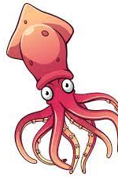
Thank You!

